Slide 1
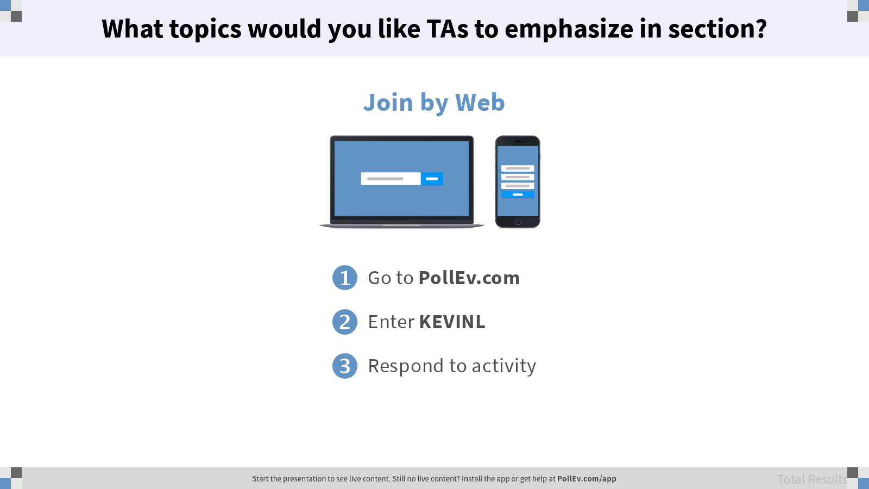
What topics would you like TAs to emphasize in section?

Slide 2

Midterm Review
… and computing in the real world.
Kevin Lin, with thanks to many others.

Slide 3
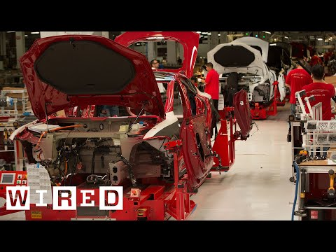

Slide 4
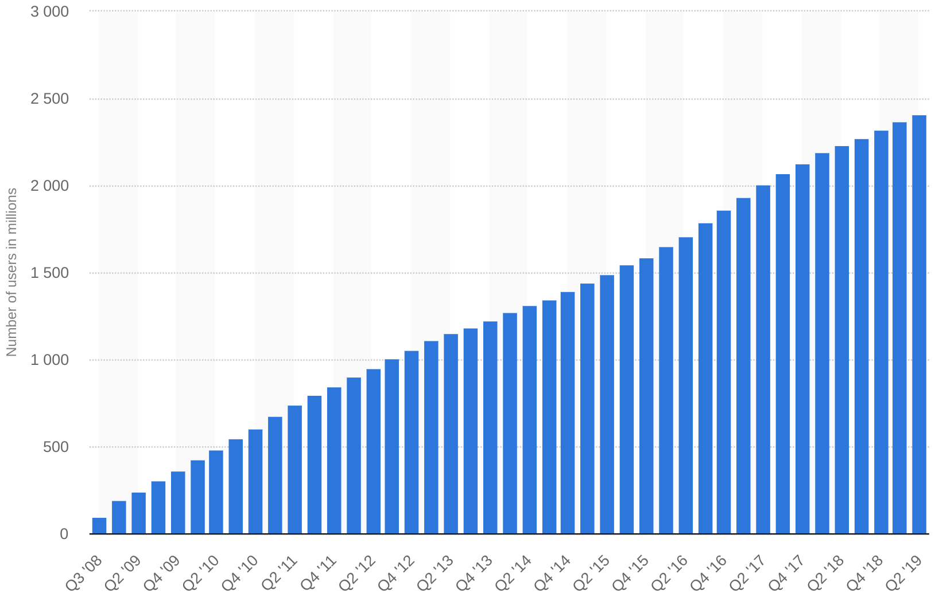
Facebook Monthly Active Users
2.5 Billion
Facebook Monthly Active Users (Statista)

Slide 5
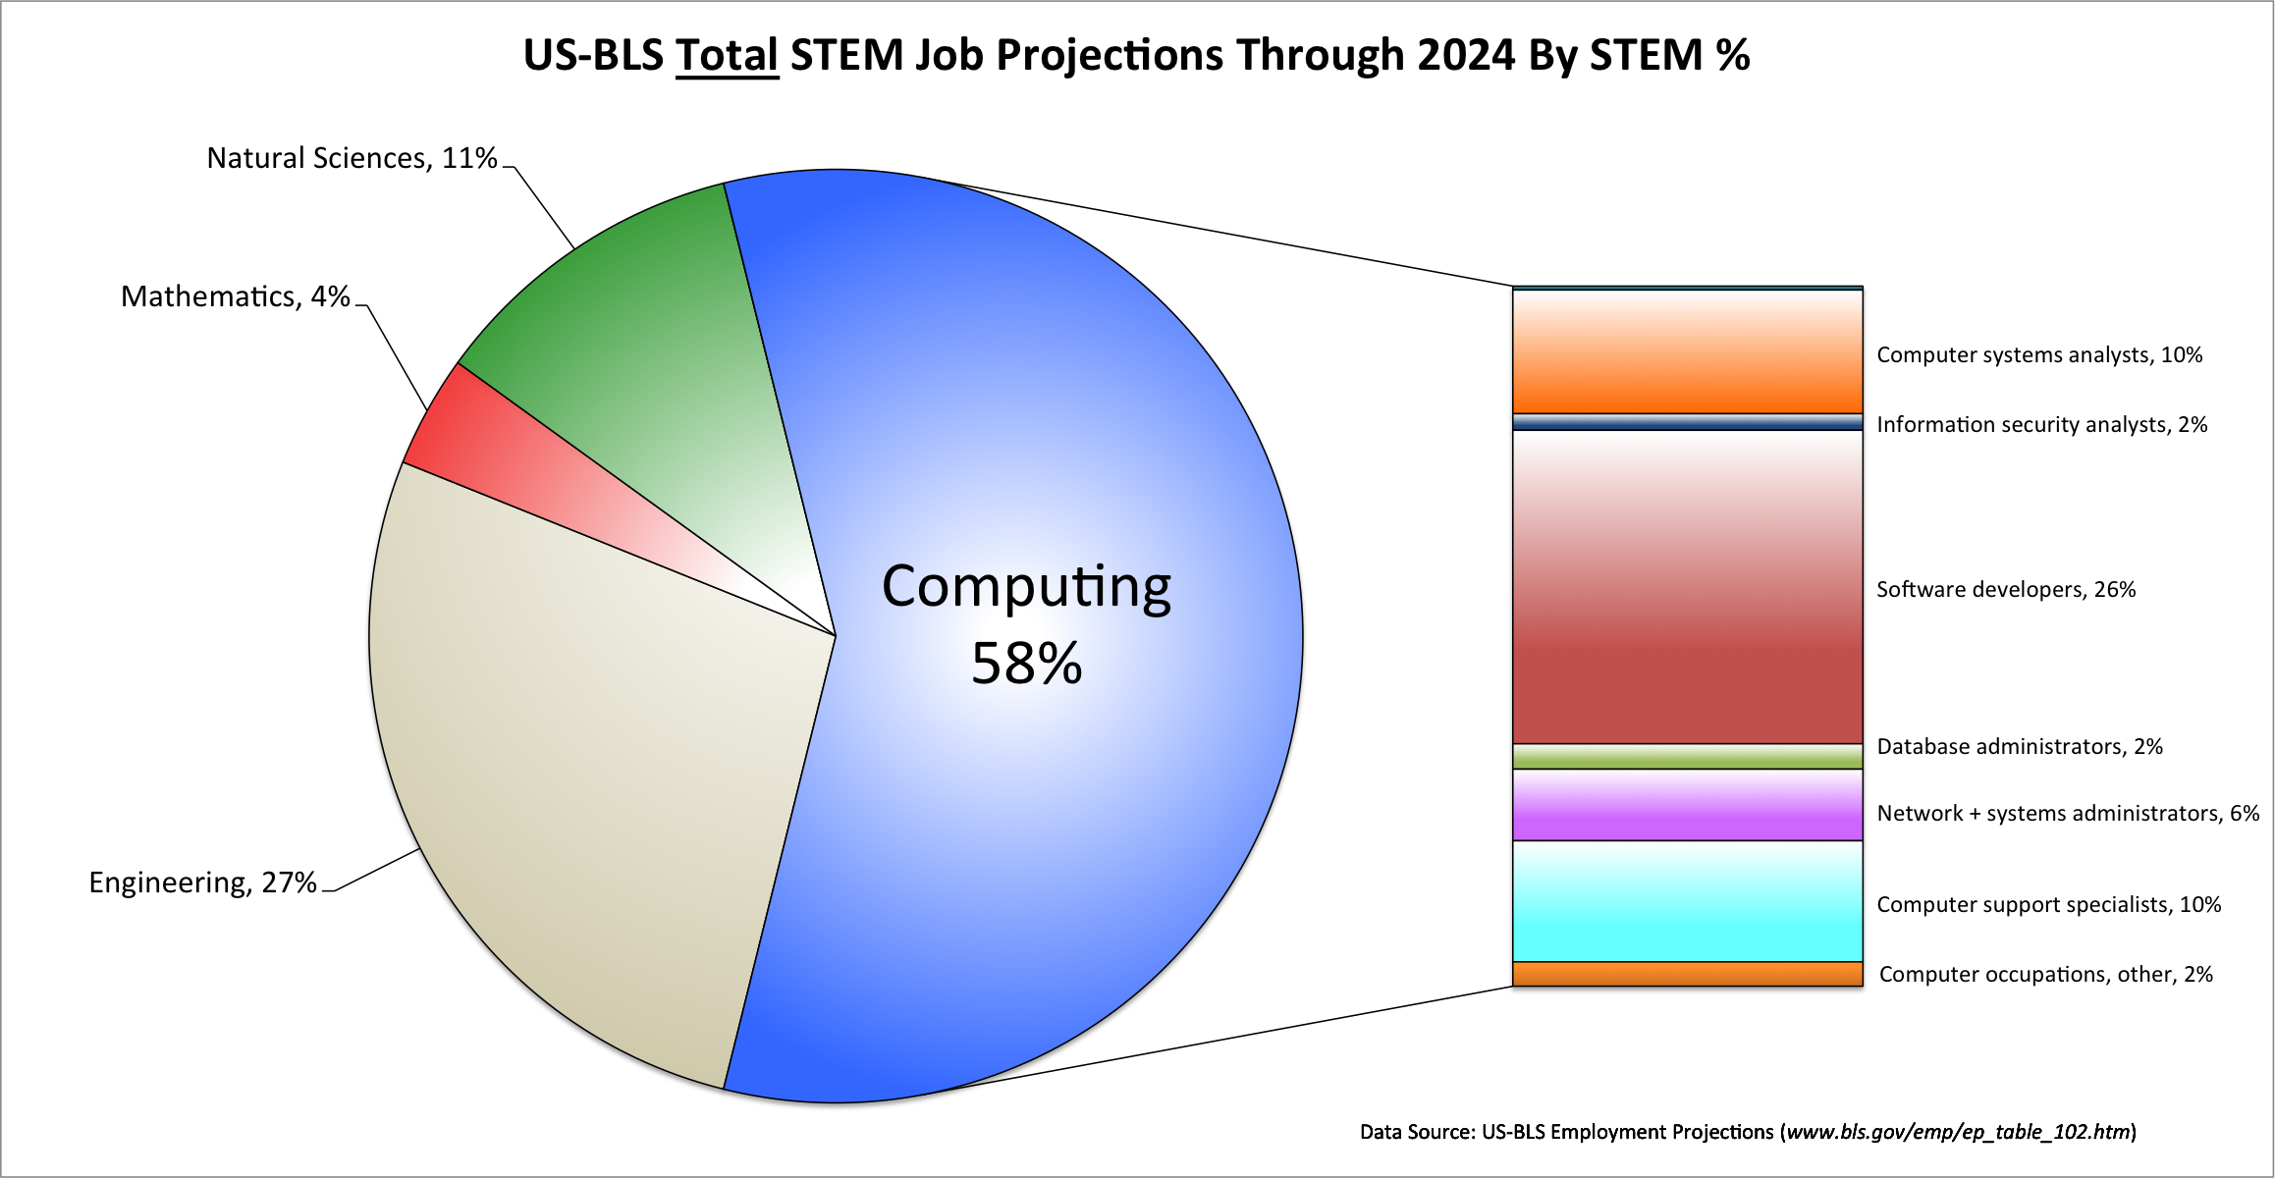

Slide 6
Current Economic Upheaval
Four trends are leading to a dramatic upheaval in society:
Urbanization.
Technological Change.
Aging Global Populace.
Shift from North American and European Trading Hubs.
“Compared with the Industrial Revolution, we estimate that this change is happening ten times faster and at 300 times the scale.”
The four global forces breaking all the trends (McKinsey Global Institute)

Slide 7
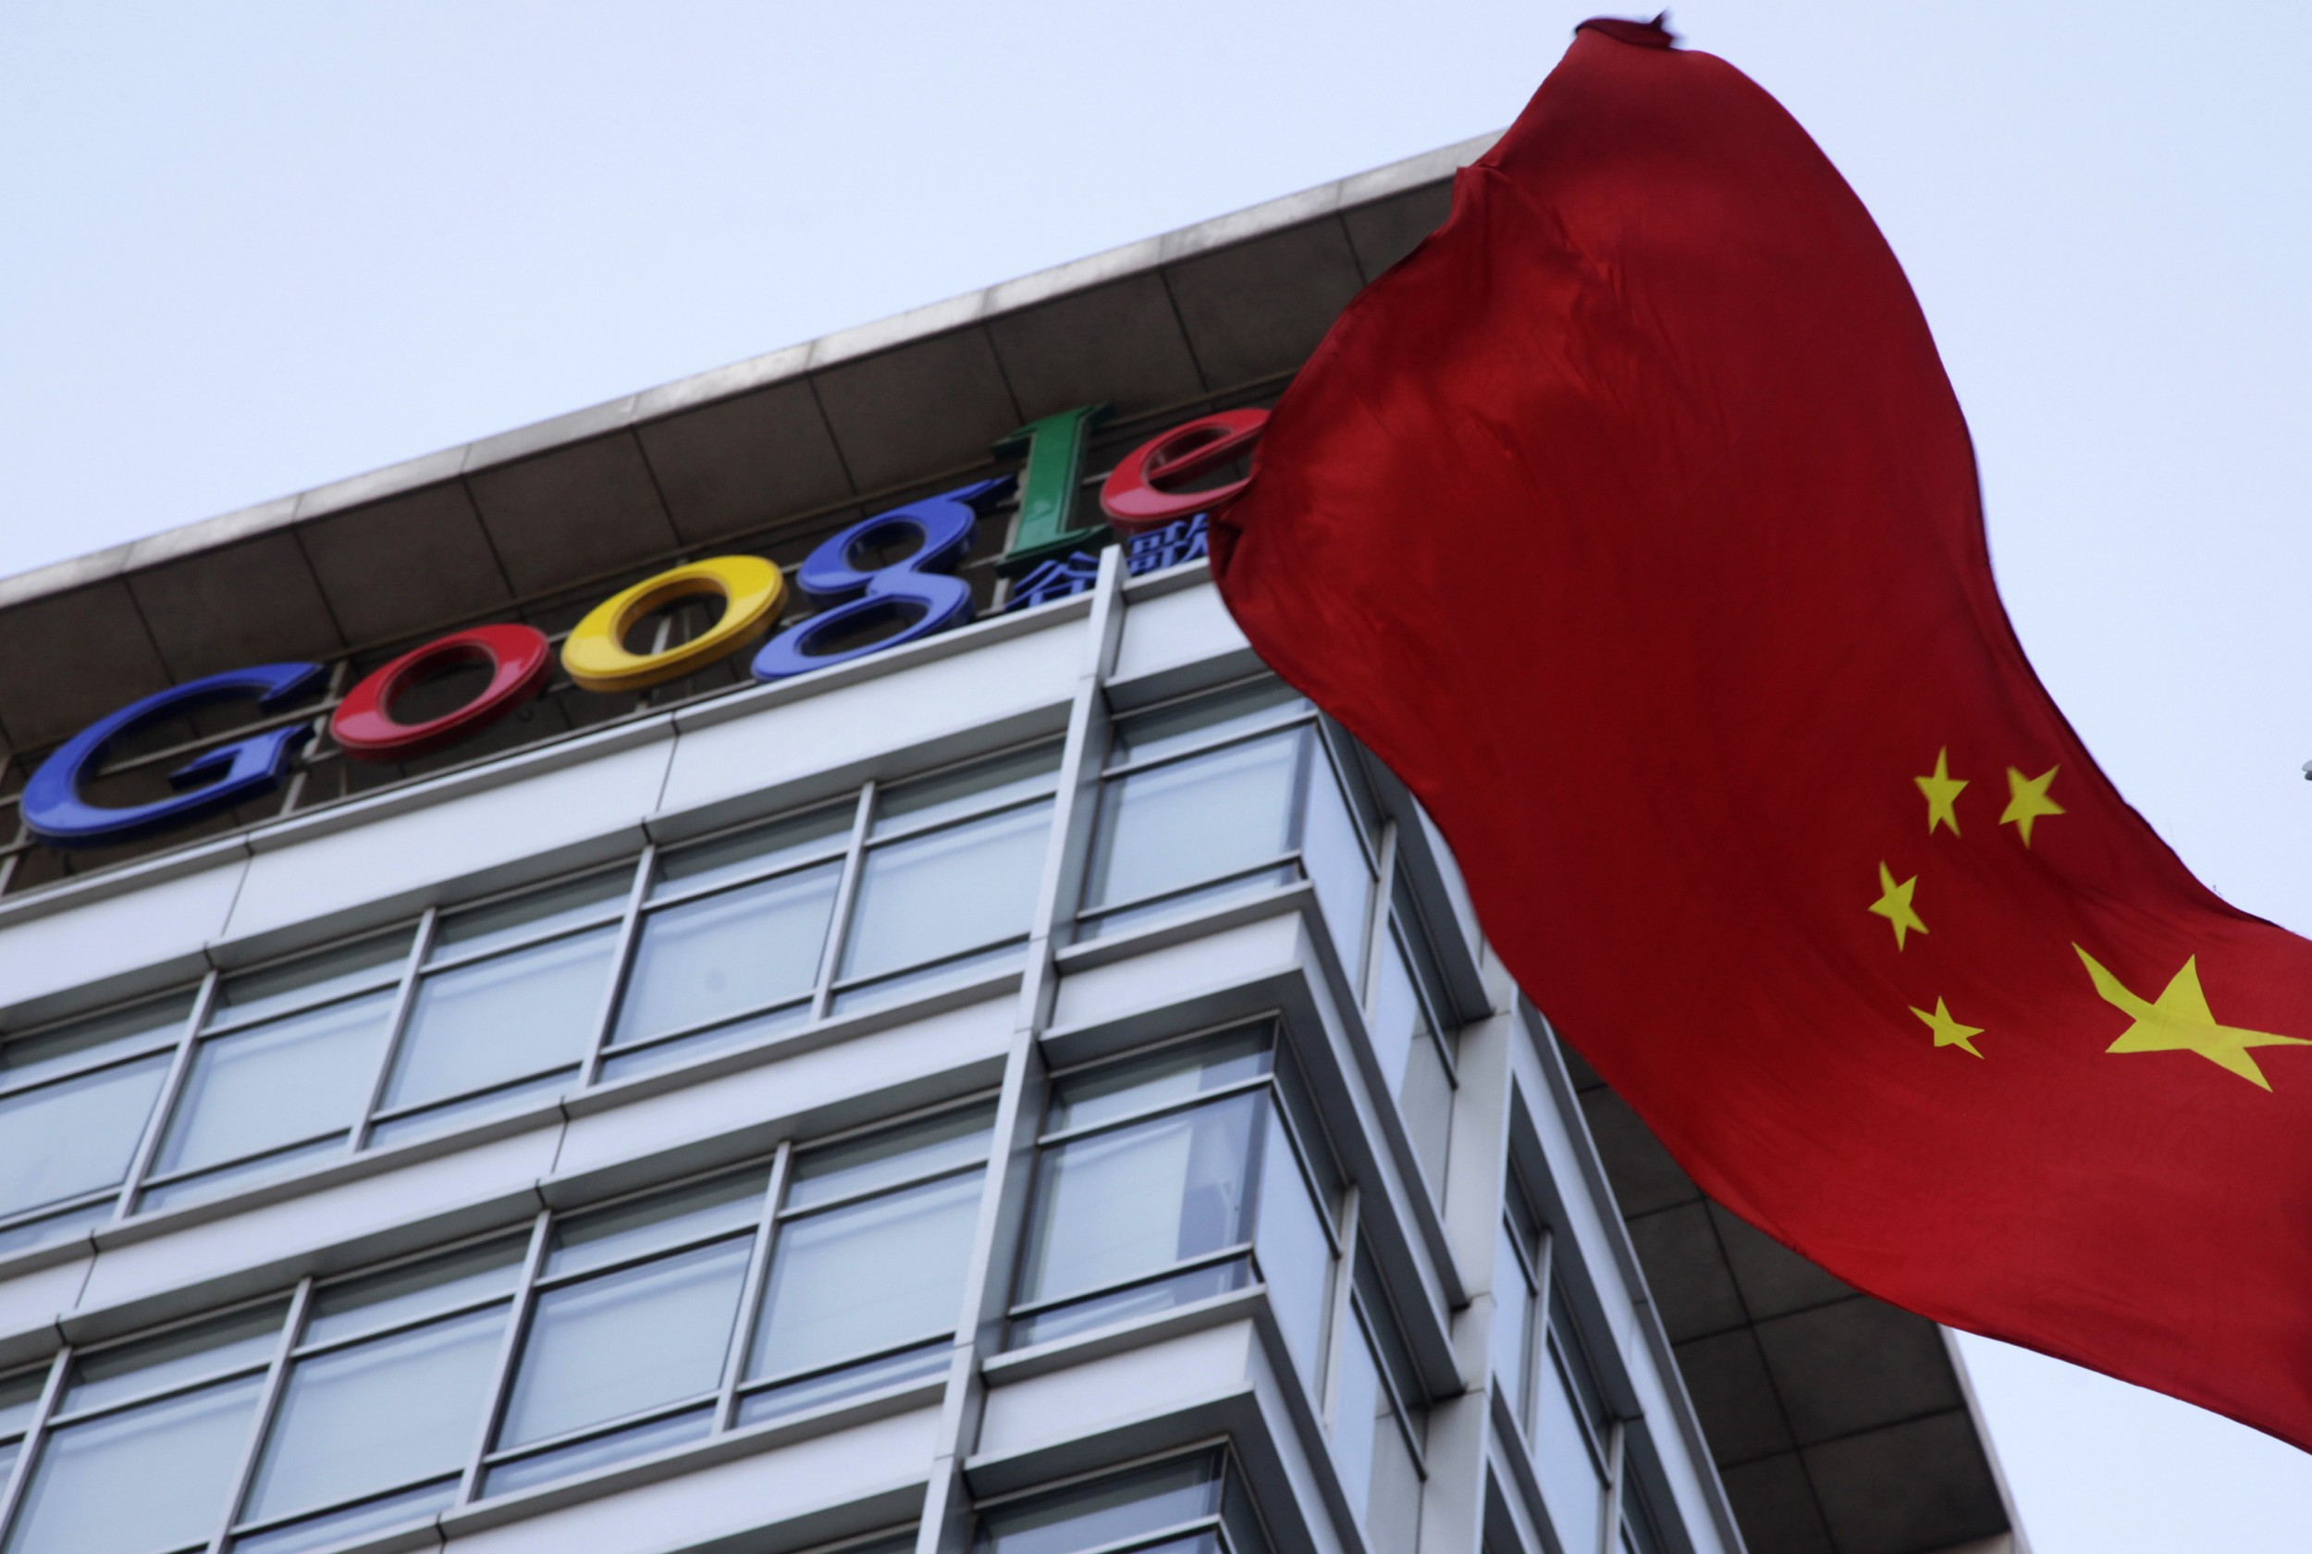
Google: Censored Search
When Google bailed out of China in 2010, shuttering Google.cn, the search giant said it could no longer abide by China’s insistence that it hide politically sensitive results. In a blog post, the chief legal officer of Google made a “promise to stop censoring search.”
So much for promises. A team of as many as 100 Googlers has been at work on “Project Dragonfly,” an effort to build a new search engine for China.
The biggest technology failures of 2018 (Antonio Regalado/MIT Technology Review, Ng Han Guan/AP Photo)

Slide 8

Facebook: Ethnic Cleansing
A large team of Myanmar military officers [...] systematically used Facebook to set the stage for ethnic cleansing against that country’s mostly Muslim Rohingya minority in 2016. They employed [a] mix of fake news and troll accounts to stoke religious hatred and public fear before they set out to rape and kill Rohingya people and burn their villages. [...]
Facebook hasn’t been able to stop its product from being used as a platform for organized hate crimes.
The biggest technology failures of 2018 (Antonio Regalado/MIT Technology Review, AP)

Slide 9
Voting with Your Feet

Slide 10
Because of your education and skills, your actions will have enormous impact.

